Slide 1
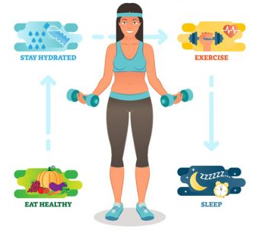
Hormones, metabolism and feedback loops
GTHBY Human Biology

Slide 2
Review
Name three organs of the endocrine system.
Name three hormones
Organs can belong to more than one system – give an example of an organ that is part of the endocrine system but is also part of another system.

Slide 3
Learning Intentions
Components of negative feedback: receptor, modulator, effector, response and feedback
The metabolic effects and negative feedback loops for cortisol, growth hormone and adrenaline

Slide 4
Success Criteria
Draw a diagram to represent a feedback loop
Give an example of a receptor, modulator, effector, response and feedback
Define metabolism
Describe the effects of cortisol, growth hormone and adrenaline.

Slide 5
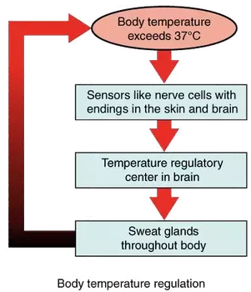

Slide 6
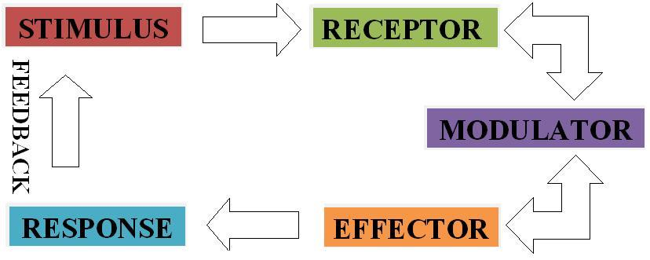
Feedback Loops

Slide 7
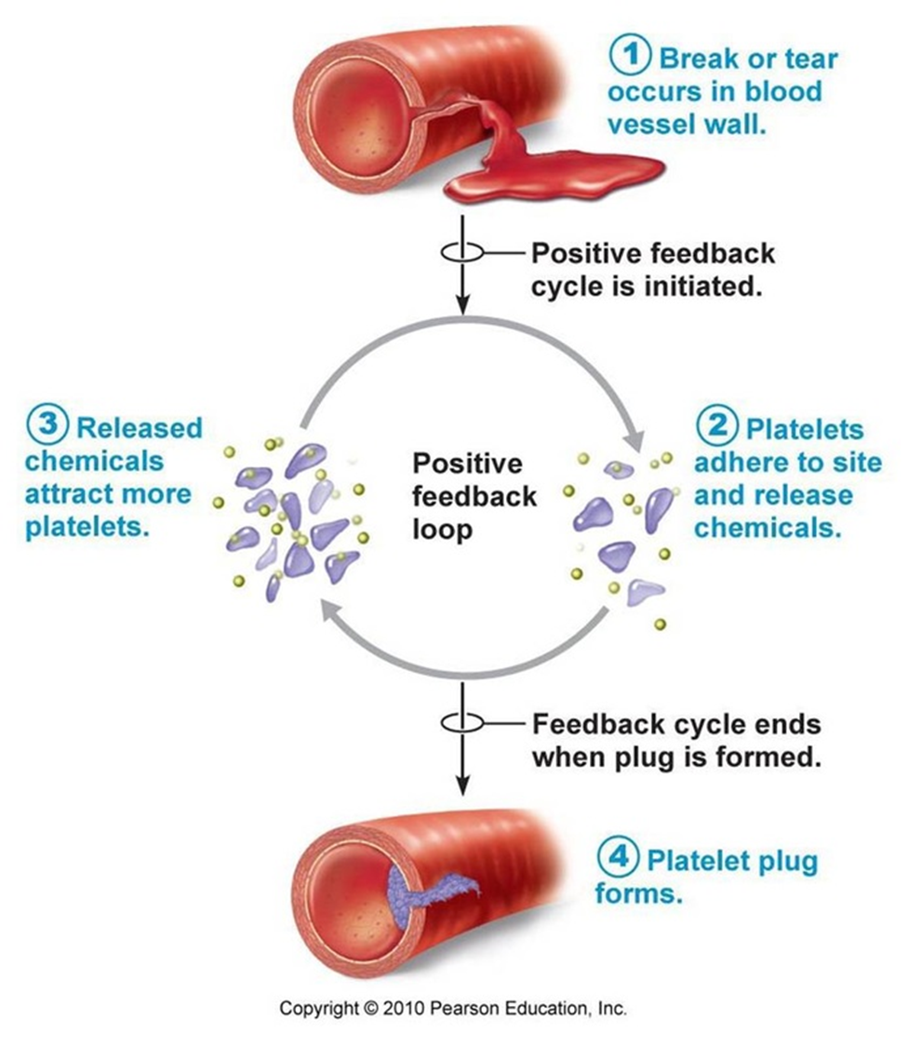

Slide 8
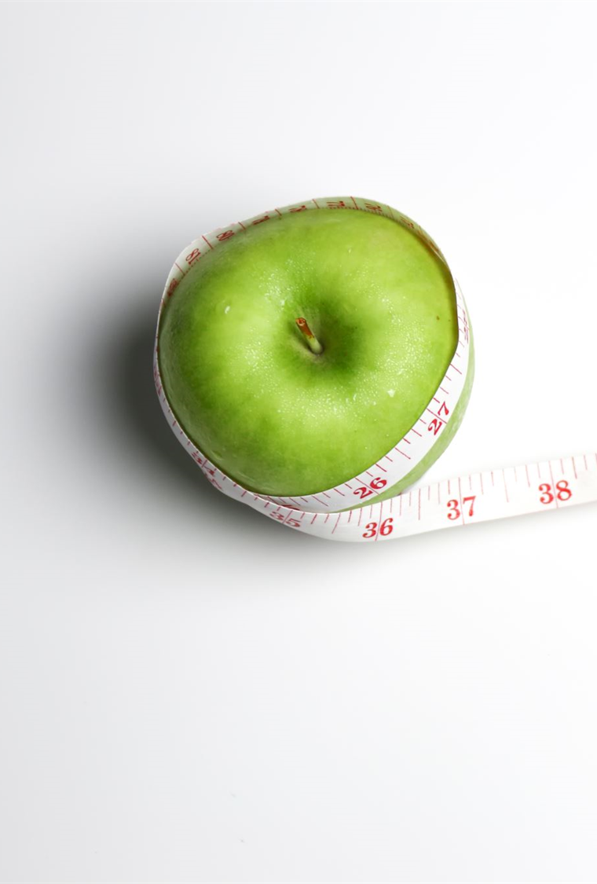
Metabolism
Metabolism is the process by which your body converts what you eat and drink into energy.

Slide 9
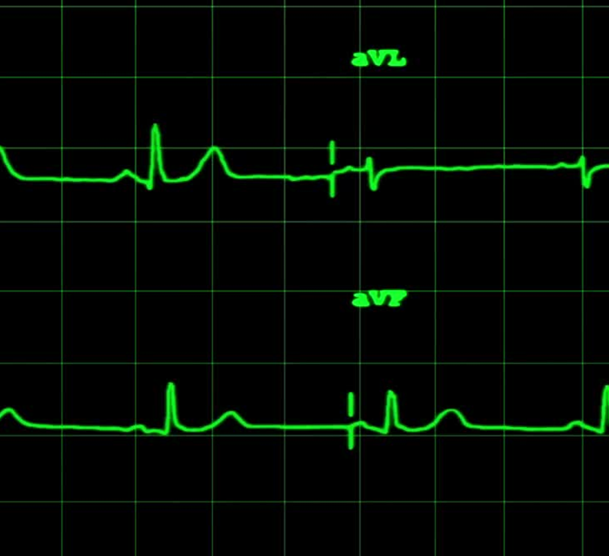
Basal Metabolic Rate
BMR is the minimum amount of energy required by the body to maintain life at complete mental and physical rest.

Slide 10
Factors affecting BMR
Surface area
Sex (Male BMR tends to be about 5% higher)
Age (Decreases about 2% each decade)
Physical activity (increases if you exercise regularly)
Hormones (Thyroid, cortisol, sex hormones and growth hormones all increase BMR)
Environment (Colder temp increases BMR)

Slide 11
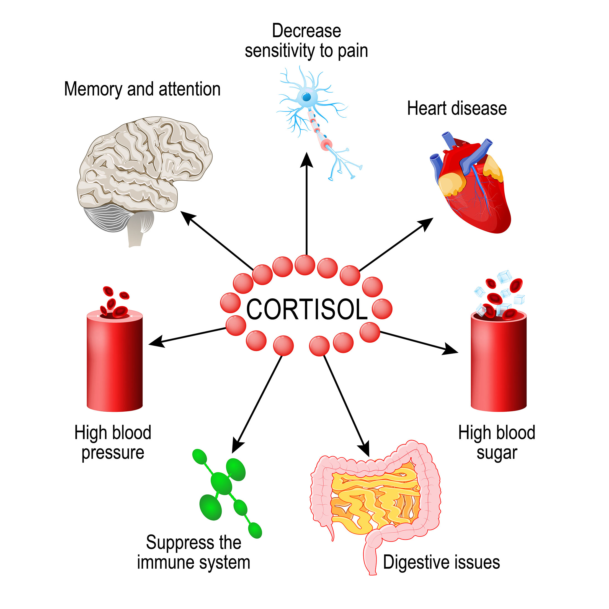

Slide 12
Jigsaw research
Source
Effect(s)
Receptor(s)

Slide 13
Success Criteria
Draw a diagram to represent a feedback loop
Give an example of a receptor, modulator, effector, response and feedback
Define metabolism
Describe the effects of cortisol, growth hormone and adrenaline.

